Slide 1

Prepared by group 14
Smart Voice Assistant
Python Project

Slide 2
Team Members
Pachigulla Joshika
AP23110011569
Kunam Day Harika
AP23110011607
Aasritha Daisy Lam
AP23110011610
Sakala Bhagya Sri
AP23110011618

Slide 3
Introduction
Our project is a python-based voice assistant designed to perform tasks using voice commands.
Named 'Sophia', the assistant integrates voice recognition, text-to-speech, and automation features.
It is useful for daily productivity and hands-free operation of basic tasks.

Slide 4
Technologies Used
•Python
•Eel (for connecting Python with frontend)
•pyttsx3 (Text-to-Speech)
•SpeechRecognition (Speech-to-Text)
•PyAutoGUI, Requests, Wikipedia, pywhatkit, etc.

Slide 5
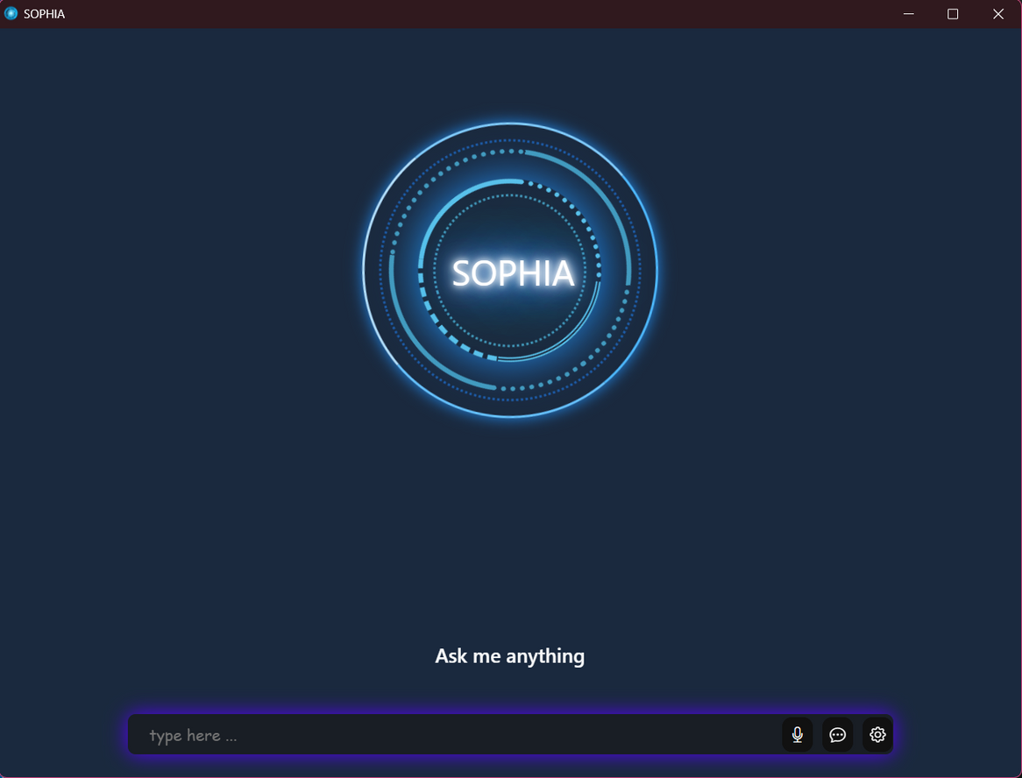
Front End

Slide 6



System Architecture
Voice Input
Command Processing
Action Execution
Frontend
SpeechRecognition captures user input
Keywords parsed and directed
Features executed via Python modules
Connected using Eel and displayed in browser

Slide 7
Key Features
•Open applications and websites
•Play YouTube videos
•Fetch latest news and stock prices
•Take notes and screenshots
•Search Google/Wikipedia
•Set alarms and timers

Slide 8
Methodology
How Commands Work
User speaks a command (e.g., 'play music on YouTube')
Speech is recognized and converted to text
Text is analyzed to identify the required action
Corresponding function is called (e.g., PlayYoutube)

Slide 9
Interesting Code Logic
Dynamic command routing in command.py
Threading used for alarms without blocking UI
Fallback logic for app/URL handling in openCommand()
Error handling in Wikipedia and News fetching

Slide 10
Frontend Integration
Eel used to bind Python backend with a web frontend
Voice responses and messages displayed via HTML/JS
Browser launched as a desktop app using Chrome app mode

Slide 11
EXAMPLE USECASE
•User says: 'Set a timer for 2 minutes'
•Assistant processes and waits 2 minutes
•Then says: 'Time's up!' via speaker and browser UI

Slide 12
FUTURE SCOPE
Better understanding: Improve how the assistant understands what we say by using smarter language tools.
Voice lock: Add a feature to recognize the user’s voice for security.
Always listening mode: Make it listen for a wake word like “Hey Assistant” without clicking a button.

Slide 13
Conclusion
In this project, we built a voice assistant that can understand our voice, perform different tasks like opening apps, searching online, reading news, setting alarms, and more. It talks back to us using text-to-speech and shows messages on a simple interface. The assistant works well, and the project shows how we can use Python to control a computer using voice commands.

Slide 14
Thank you

